Slide 1
STUDENT REPORT SYSTEM

Slide 2
ABSTRACT
The main objective of our project is to simplify the evaluation of final percentages ,grades of the students and to know holiday dates ,examination dates etc. which is done by the “FACULTY”. Basically ,where ever we go in the whole globe ,the first thing the other fellow being ask, is our “ EDUCATIONAL STATUS ”. So, we have decided a project called “STUDENT REPORT SYSTEM” .
The project “Student Report System” basically deals with the calculation of the percentages , grades and total marks of the student. This makes the work of the faculty easier, comfortable. .
The Report System contains the details of the Pupil and Every student information will be allocated in a file. Where they need to enter the roll no and password which accesses their document. Every time as they take examination, their new score will be appended into their respective file and new grade, percentage will be displayed. Along with examination dates and holiday dates will be acknowledged. This gives both the faculty and parents to have a brief idea about their ward’s performance.

Slide 3
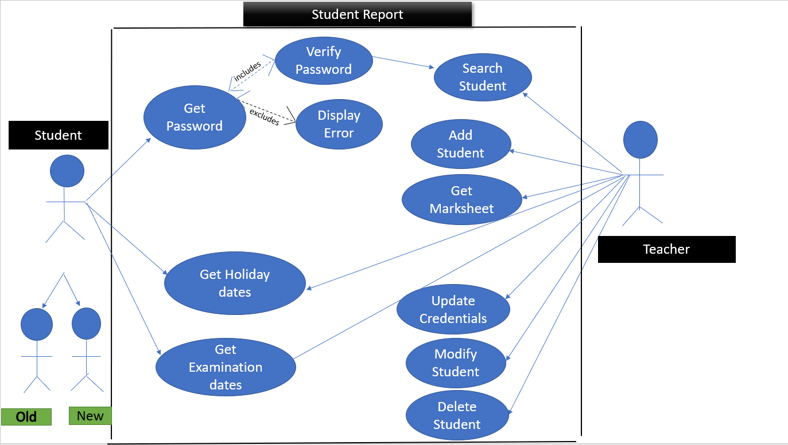
USE CASE DIAGRAM

Slide 4
TECHNOLOGY USED
All computer software needs certain hardware components or other software resources to be present, in order for computers to be used efficiently. These prerequisites are known as System Requirements. Within this, we have two types – Software Requirements and Hardware Requirements.
SOFTWARE REQUIREMENTS
Software Requirements deal with defining the software resource requirements and prerequisites that need to be installed on a computer to provide optimal functioning of an application. These preconditions are generally not included in the software installation package and need to be installed separately.
In order to use CODIAC, one should have the following:
Operating System: Windows 7 and above
C Compiler: GNU Compiler Collection (GCC)
Editor: Any text editor .
HARDWARE REQUIREMENTS
Hardware requirements refer to the common set requirements defined by any operating system or software application and are usually the physical computer resources. In this, we look into the architecture, processing power, memory, secondary memory, display adapter and peripherals.
In order to use this project, one should have the following:
Processor: Intel Pentium processor and above
Memory: 4 GB RAM and above

Slide 5
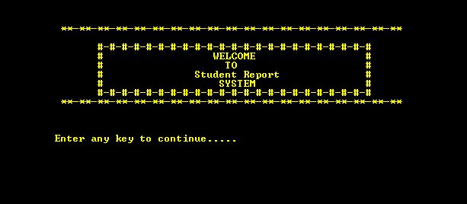
RESULTS:-

Slide 6
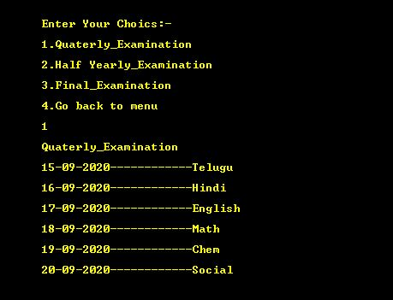
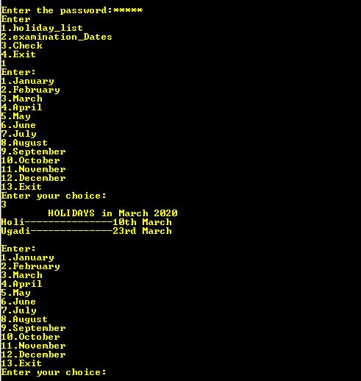

Slide 7
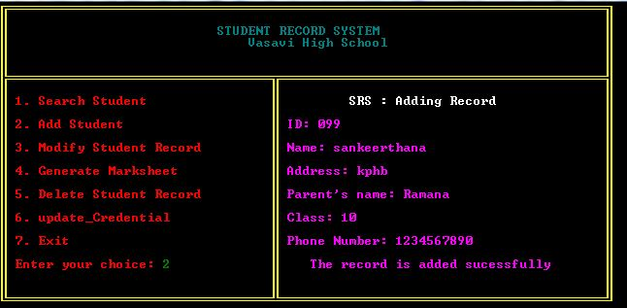
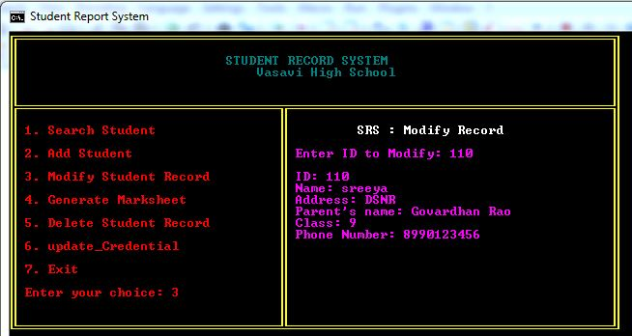

Slide 8
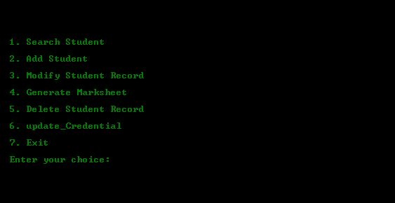
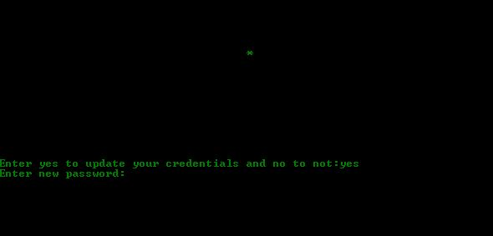

Slide 9
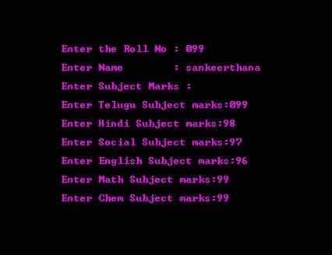
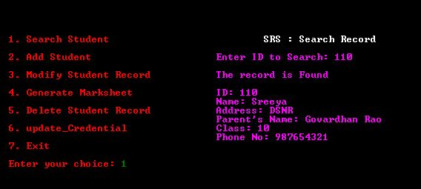

Slide 10
CONCLUSION AND FUTURE WORKS
To conclude, this application is useful for educational institutions. It triggers user-friendly operations.Our Future work is to develop the application in PHP Or HTML to make this console application as a web application. And also develop using DBMS to increase the scope.

